Slide 1
Spatial Analysis

Slide 2
What is Spatial analysis ?
Heart of GIS which allows to study real-world processes.
It is the spatial analysis capabilities that distinguish GIS from other data processing systems.
Part of a decision-making process.
Important use of analysis is predicting what will happen after certain time which provides the opportunity to select the best possible alternatives.

Slide 3
Spatial Analysis
Analytical capabilities of a GIS use spatial and non-spatial (attribute) data to answer the questions and solve problems that are of spatial relevance.
Analysis of spatial data can be defined as computing new information that provides new insight from the existing, stored data.

Slide 4
Spatial Analysis
Spatial analysis is a process for looking at geographic patterns in data and relationships between features. The actual methods used can be simple-just a map of the theme being analyzed or more complex involving models that mimic the world by combining many data layers.
Spatial analysis allows us to study real-world processes. It gives information about the real world that may be the present situation of specific areas and features or the changes or trends in a situation. For instance, it may be able to answer 'where and by how much are forest areas decreasing or increasing?' or 'where are urban areas growing in the Kathmandu valley?' and so on.
Spatial analysis once coupled with temporal analysis (time dimension) makes GIS very powerful and useful tool.

Slide 5
(History Time)
How did Spatial Analysis start concretely ??
(In a non-computerized context)

Slide 6
(History Time)
In 1854, Soho district of London saw one of worst outbreaks of Cholera resulting in 616 deaths.

Slide 7
(History Time)
Cholera being a water borne disease was transmitted from contaminated pump.
It was necessary to pinpoint the contaminated pump among many.

Slide 8
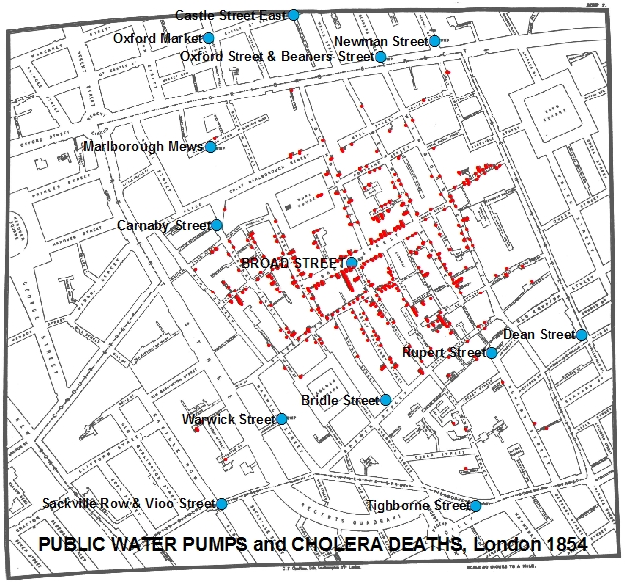
(History Time)
Physician John Snow mapped the location of water pumps along with incidents of death due to cholera.
This was done in non-computer based environment. Of course computers didn’t exist in 1854.

Slide 9
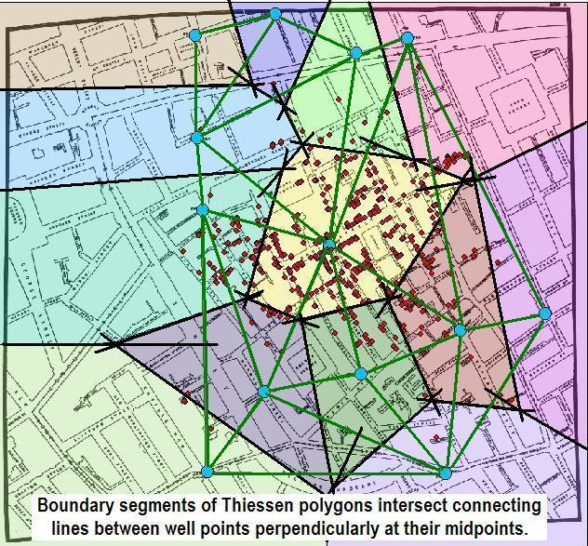
(History Time)
Snow drew Thiessen polygons around the wells, defining straight-line least-distance service areas for each.

Slide 10
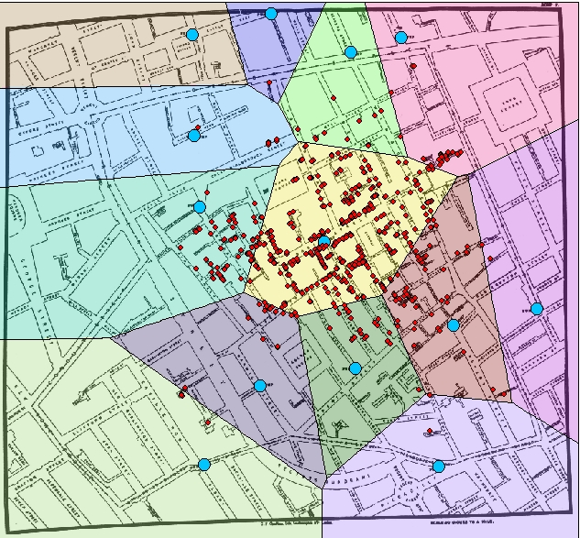
(History Time)
Any point within the thiessen polygon is closest to the pump within the theissen polygon.
It means source of water for homes within the theissen polygon is the same pump.

Slide 11
(History Time)
Snow computed the total number of incidents of death per water pump.

Slide 12
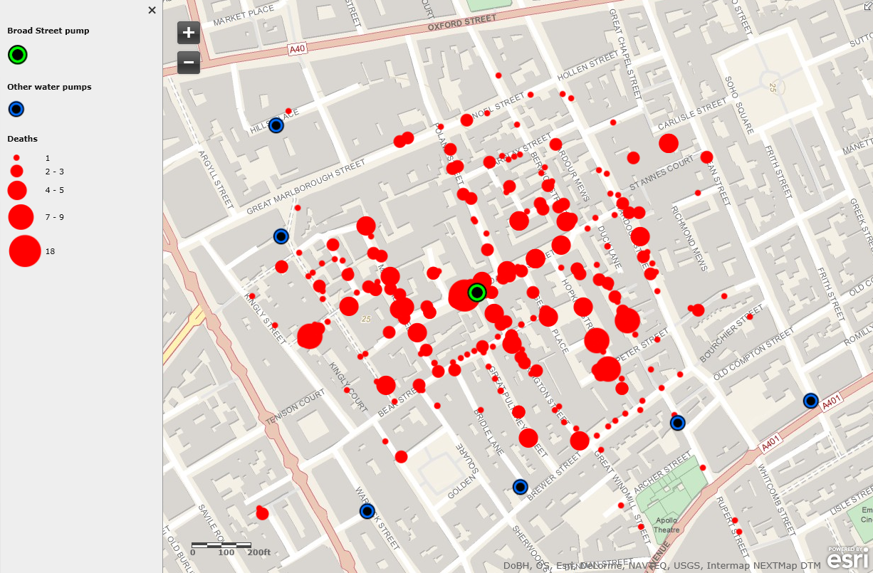
(History Time)
Snow, with his findings from spatial analysis persuaded local authorities to stop the supply from Broad Street Pump which helped to subside the cholera outbreak.

Slide 13
Spatial Analysis
Spatial analysis involves a process or method for how GIS tools are applied to any number of problems.
Stages | Steps in Spatial Analysis
1 Establish an objective and frame the question(s) you want to answer.
2 Gather, organize, and prepare the data for analysis.
3 Build the analysis model
4 Execute the model and generate results.
5 Explore, interpret, and analyze the results.
6 Make decisions and conclusions.
7 Present your results and findings.
In real practice, this process is iterative. A review is conducted at each step, enabling the opportunity to incorporate new information, ideas, methods, models, etc.

Slide 14
Spatial Analysis Functions

Slide 15
Spatial Analysis Functions
Measurement, retrieval and classification functions
Overlay
Neighborhood Functions
Connectivity (Network) functions

Slide 16
1a. Measurements
Measurement on vector data
Location
Length
Area
Distance
Measurement on raster data
Location
Area
Distance

Slide 17
1b. Retrieval
Retrieves the attribute data without altering existing data
Interactive Selection : Using mouse cursor to select
Spatial Selection by Attribute conditions (Attribute Query)
Relational operators
Logical operators
Combining attribute conditions
ii) Spatial selection using topological relationships (Spatial Query)
Selecting features that are inside selection objects
Selecting features that intersect
Selecting features adjacent to selection objects
Selecting features based on their distance

Slide 18
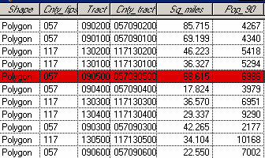
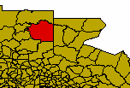
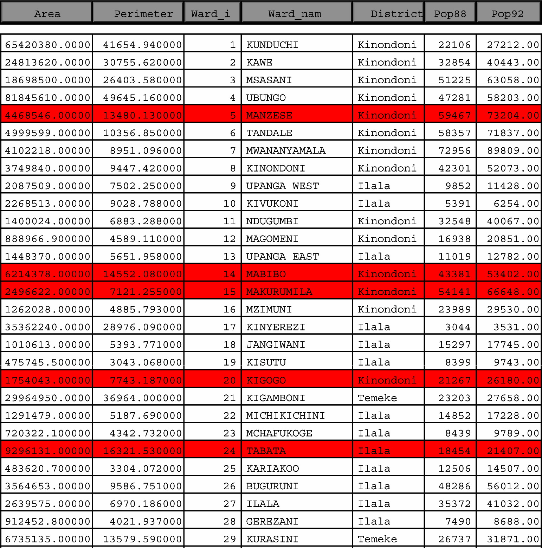
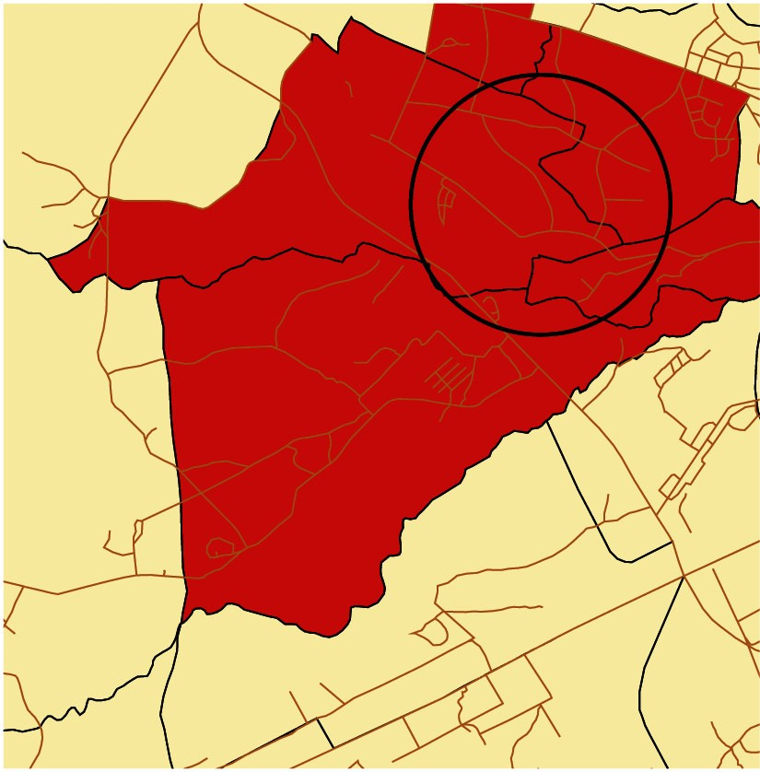
i) Interactive Selection : Using mouse cursor to select

Slide 19
ii) Spatial Selection by Attribute conditions
Selection by attributes is done using SQL (Structured Query Language)
It selects the features that fulfill the conditions
Eg: Select all districts whose population is greater than 1 million.
For selection by attributes we can use the following operators:
Relational operators
>, <, =, <>, >=, <=
Logical operators
AND, OR, NOT, XOR
Combining attribute conditions
Both relational and logical operators are used (eg: (A>100 and B<50)

Slide 20




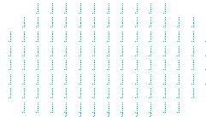




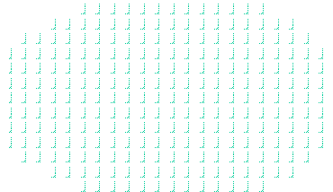








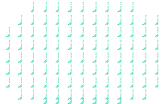
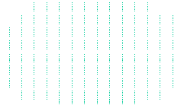
iii) Spatial Selection using topological relationships
disjoint
covered by
meet
equal inside
contains
covers overlap

Slide 21
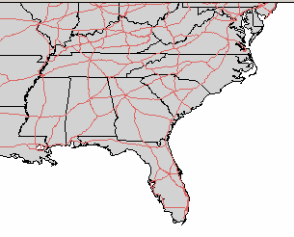
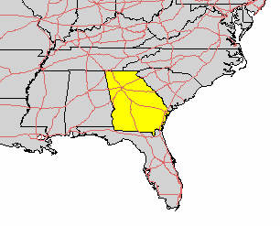
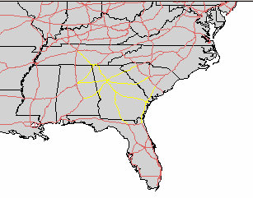
Eg: Selecting features that intersect
Select the highways that run (partly) through the state Georgia. First select the state Georgia, then select all the highways that intersect the selected state. (OVERLAP)

Slide 22
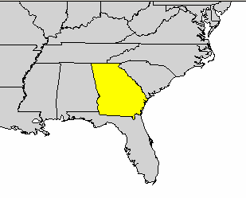
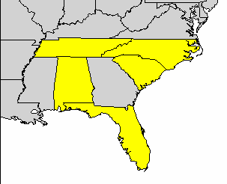
eg: Select features adjacent to selected objects
Select all the states that are neighbors of the state Georgia. (MEET RELATIONSHIP)

Slide 23
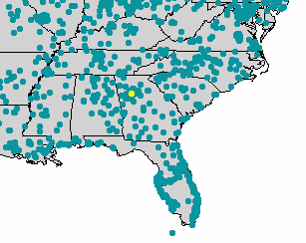
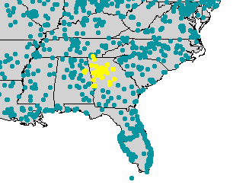
Eg: Selecting features based on their distance
Select all cities within a distance of 100 miles of Atlanta

Slide 24
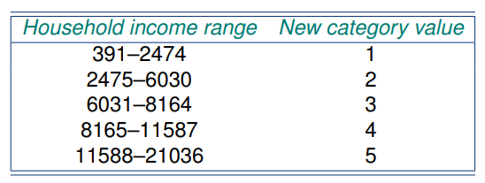
c) Classification
Classification purposefully removes the details from an input data to reveal important patterns.

Slide 25
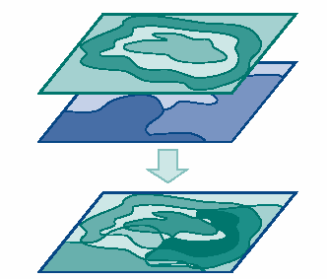
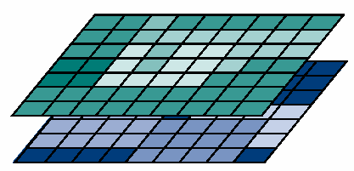



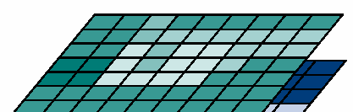
2. Overlay Operations
Standard overlay operators take two input data layers, and assume they are georeferenced in the same system, and overlap in study area.
If either condition is not met, the use of an overlay operator is senseless.
The principle of spatial overlay is to compare the characteristics of the same location in both data layers, and to produce a new output value for each location.
Core of GIS analysis which combines several spatial features and gives new information, i.e. new spatial elements. Examples: polygon on polygon, line on polygon and point on polygon.
Combination of maps using arithmetic, relational, or conditional operators, and different functions

Slide 26
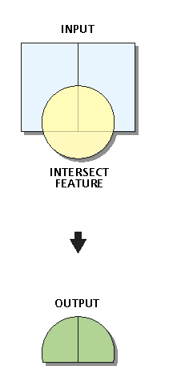
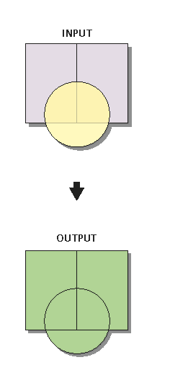
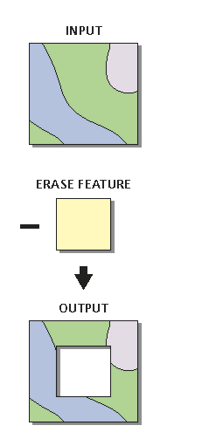
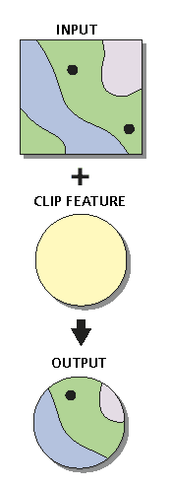
2a) Vector overlay Analysis
Intersect
Clip
Union
Erase

Slide 27
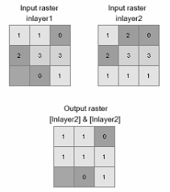
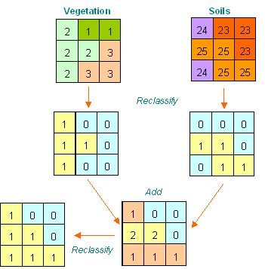
2b) Raster overlay Analysis

Slide 28
3. Neighborhood functions
Will find out characteristics of the vicinity (neighborhood) of a location
To perform neighborhood analysis we must
State which target locations are of interest to us, and what is their spatial extent
Define how to determine the neighborhood for each target
Define which characteristic(s) must be computed for each neighborhood

Slide 29
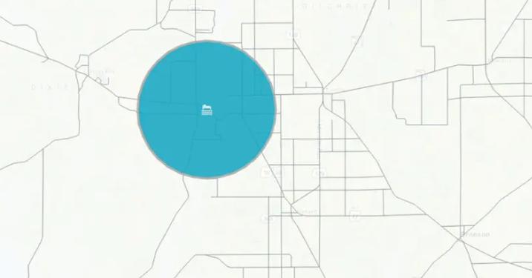
Neighborhood functions
Target: medical clinics
Neighborhood : buffer
Characteristics
How many people live in the area
What is their average household income
Are there any high-risk industries located in the neighborhood

Slide 30
Neighborhood functions
i) Proximity computation (geometric distance)
a)Buffer generation (Vector and Raster)
b)Thiessen polygons (Vector)
ii) Spread computation (Computation of diffusion)(Raster)
ii)Seek computation (Computation of flow)(Raster)

Slide 31
i.a) Neighborhood functions: Buffering
The principle is to draw a zone of interest around an object (points, lines or areas) at an equal distance in all directions to find its neighbourhood characteristics.
The result being features, which represent areas.
Buffers creates a circular, corridor or polygon shaped zone around objects/ features at set distances.
Line buffer
Polygon/ Area buffer
Point Buffer
r

Slide 32
Examples of Buffering
zone of noise pollution around an Airport /highways (e.g. creation of buffers around an airport to calculate zones of different noise intensity.
Service zone around bus route (creation of buffers of 300 m walking distance around each bus stop e.g.)
All residential buildings away from a street network (600 feet from a major street, 200 feet from a secondary street, and only 100 feet from a tertiary street )

Slide 33
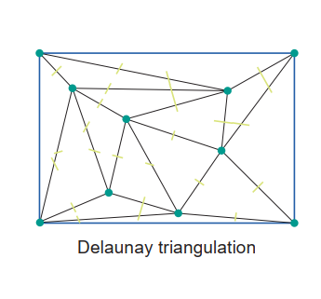
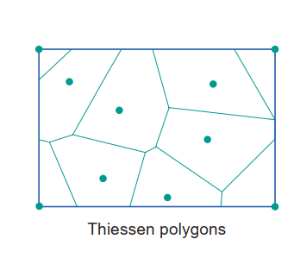
i.b) Thiessen polygon generation
Partitions the plane into polygons so that each polygon contains locations that are closer to the polygons' midpoint than to any other midpoints.
It is easier to construct thiessen polygon based on Delaunay triangulation

Slide 34
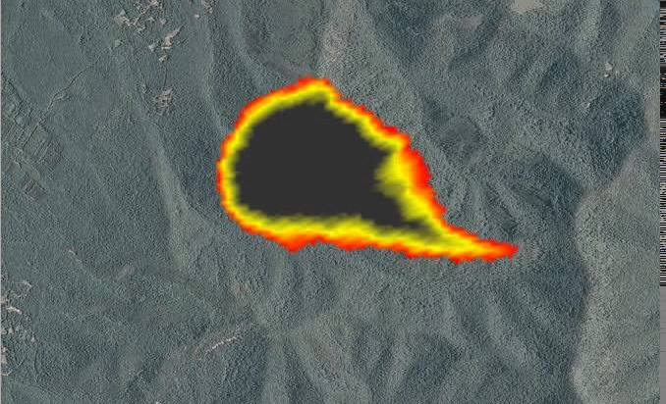
ii) Spread computation(Computation of diffusion)(Raster)
Spread computations determine how a phenomenon spreads over the area, in principle in all directions, though with different difficulty or resistance.
Examples: Forest fire, pollution from a source

Slide 35
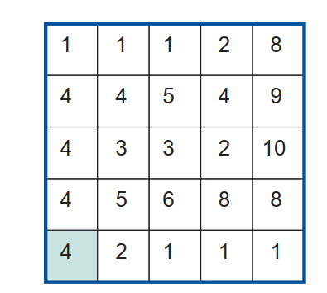
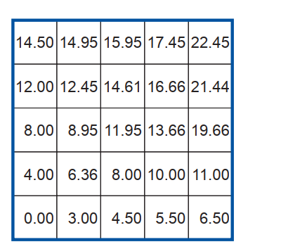
ii) Spread computation(Computation of diffusion)(Raster)
Spread computation has a source(eg: point pollution source) and a local resistance raster.
The accumulated resistance along a path of cells is simply the sum of these incurred resistances .
The ‘source material’ follows the habit of taking the easiest route to spread, the minimal resistance (cost) is computed.
Resistance Raster
Minimum Resistance Raster
SOURCE

Slide 36

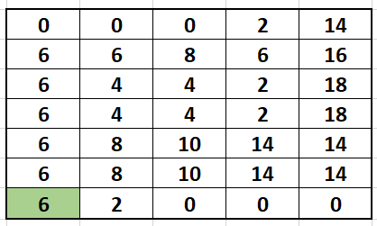
Compute the minimum resistance (impedance or cost) raster for the following resistance raster yourself.

Slide 37
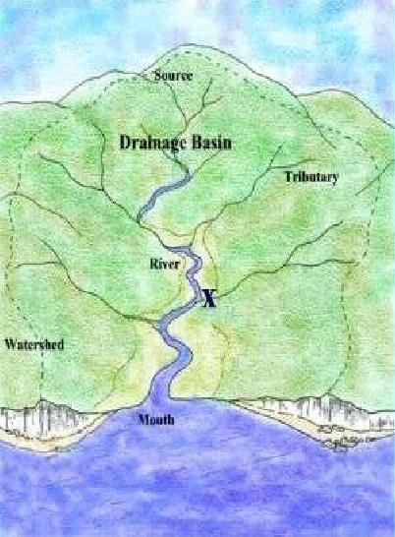
iii) Seek Computation (Flow computation)(Raster)
There are, however, also cases where a phenomenon does not spread in all directions, but only along a chosen, least-cost path, determined again by local terrain characteristics.
The typical case arises when we want to determine the drainage patterns in a catchments area: the rainfall water ‘chooses’ a way to leave the area. This is when we use seek(flow) computations.

Slide 38
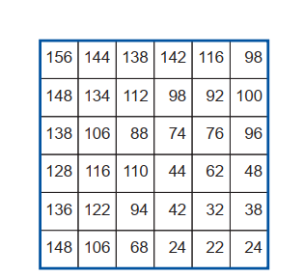
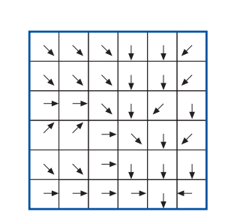
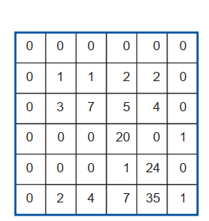
iii) Seek Computation (Flow computation)(Raster)
Elevation Raster
Flow Direction Raster
Flow Accumulation Raster
We can determine the stream network from flow accumulation raster by simply setting a threshold. Eg: Rasters with flow accumulation greater than 6.

Slide 39
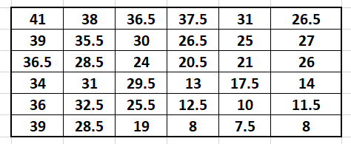
Compute the flow direction and flow accumulation raster from the given elevation raster.
*Remember water takes the path of the steepest slope.

Slide 40
4. Connectivity (Network) Analysis
commonly used for the analysis of moving resources from one location to another through a set of interconnected features.
includes determination of optimum paths using specified decision rules.
decision rules are likely based on minimum time or distance, and so on.

Slide 41
4. Connectivity (Network) Analysis
Network is a set of connecting lines
Network can represent rivers, roads, pipelines, telecommunication lines etc.
Network analysis analyze the way 'goods' can be transported along these lines
Network analysis can be done in raster or in vector.
Networks can be directed , transportation is only in one direction, for example rivers, or it can be und;rected, the goods can be transported in both directions (roads)

Slide 42
Network Structure
Network consists of lines and nodes
Lines have a direction
17
15
FNode | TNode
15 | 16
17 | 16
16 | 18
16
18
19

Slide 43
4. Network Analysis
Types of networks
Directed network and undirected network (eg: one ways are directed)
Planar network and non-planar network

Slide 44



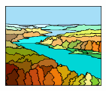


Planar and Non-planar
Multi-level crossings
Underpasses Overpasses
Embedded in a 2-dimensional plane
Non-Planar
Planar

Slide 45
Analysis on networks
i) Optimal path finding
Which generates a least cost-path on a network between a pair of predefined locations using both geometric and attribute data.
ii) Network partitioning
Which assigns network elements (nodes or line segments) to different location using predefined criteria.
Network allocation
Trace

Slide 46
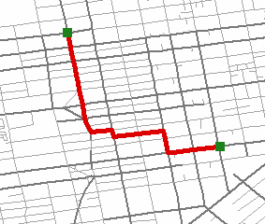
i) Network analysis - Optimal path finding
Optimal path finding is used to find the least-cost path between an origin and a destination.
You need a cost function!
Also called Impedance.
One of the attributes in the feature attribute table.
Length, travel time, etc.
The least-cost path is the one that has the min. value of the total cost between two nodes
destination

Slide 47
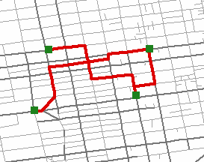
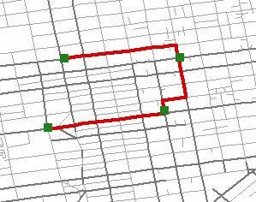
Ordered and unordered path finding
Ordered optimal path finding: the sequence in which the places have to be visited matters.
Unordered optimal path finding: the sequence does not matter.
1
3
1
3
2
2
4
4

Slide 48
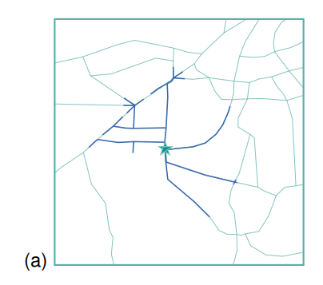
ii) Network partitioning - network allocation
The purpose is to assign lines and or nodes of the network, in a mutually exclusive way, to a number of target locations.
Assuming the stars in figure to be a school, the highlighted road network is a partition of network so that it is less than 2km from the school.
Notes:
Minimum distance model
Maximum Coverage model

Slide 49
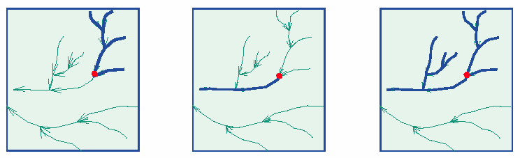
ii) Network partitioning - trace
Trace analysis is performed when we want to understand which part of a network is 'conditionally connected' to a chosen node on the network, known as the trace origin
Tracing upstream
Tracing downstream
Tracing without condition on direction

Slide 50
Create a chart of all the types of spatial analysis. Write a brief summary of each (only a few sentences is enough). Provide an example of its application, preferably relevant to land and water resources. Use a middle page to prepare the chart.

Slide 51
End of Session
Spatial Analysis

